Slide 1
Key Resume Attributes Impacting Job Callbacks
Presenter: Kejing Yan
Brown University Data Science Institute
Oct 21st, 2024
https://github.com/anyfruit/Key-Resume-Attributes-Impacting-Job-Callbacks.git
Notes:
Hello everyone, my name is Kejing Yan, and today I'll be presenting my work on analyzing key resume attributes that impact job callbacks. The objective of this project was to uncover the attributes that most influence whether or not a candidate receives a callback for a job interview.

Slide 2




Intro
Problem to Solve
Objective: Attributes influential in determining job application callback rates
Key Question: Can we predict factors increase the likelihood of receiving callback?
Why This is Important
Guiding applicants in optimizing their resumes
Beneficial to help addressing bias in hiring practices
Improving fairness and transparency in hiring processes
Type of Problem
Binary classification problem; target variable is either 1 or 0
Data Collection
Kaggle Site: https://www.kaggle.com/datasets/utkarshx27/which-resume-attributes-drive-job-callbacks
Monitored job postings in Boston and Chicago
Notes:
Our goal in this project was to determine what resume attributes drive job callbacks.
So about why is this important? In the job market, it‘s crucial for candidates to know which elements of their resumes are most impactful. Additionally, understanding these factors can help address potential biases in hiring practices, and help improving fairness and transparency in hiring processes.
This project focuses on a binary classification problem, where we predict whether a candidate will receive a callback (1) or not (0).
The data comes from Kaggle, a dataset that explores various resume and job attributes like education, experience, and skills. The data was collected from real-world job postings and candidate applications, making it highly relevant for our analysis

Slide 3
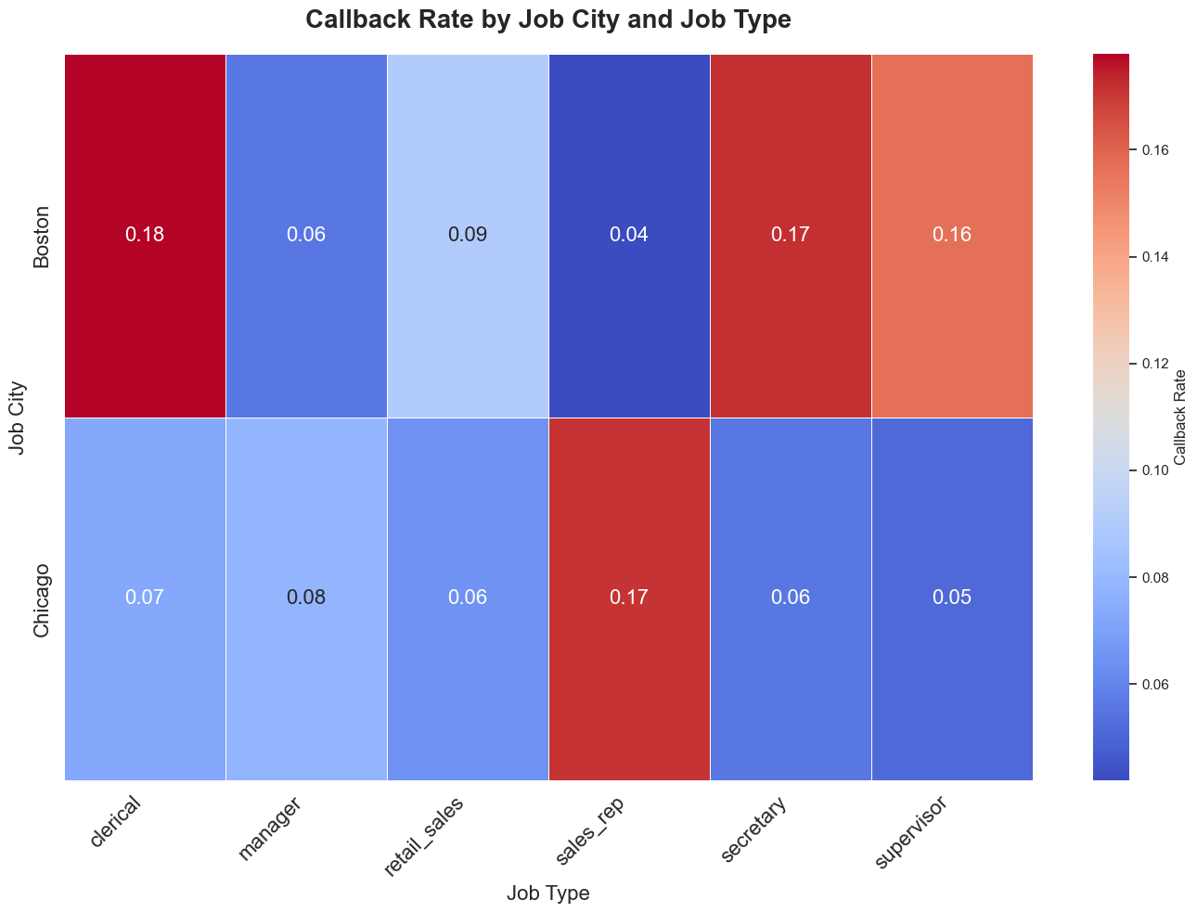

Visualization 1 (Heatmap)
EDA
Significant geographic and job-specific disparities
Boston shows higher callback rates across most jobs
Notes:
This heatmap shows the callback rate by job city and job type. One interesting insight is that Boston consistently shows higher callback rates across most job types, except for 'Sales Rep,' where Chicago outperforms Boston. This might suggest that the location of the job impacts callback rates, potentially due to different industry demands in these cities.

Slide 4
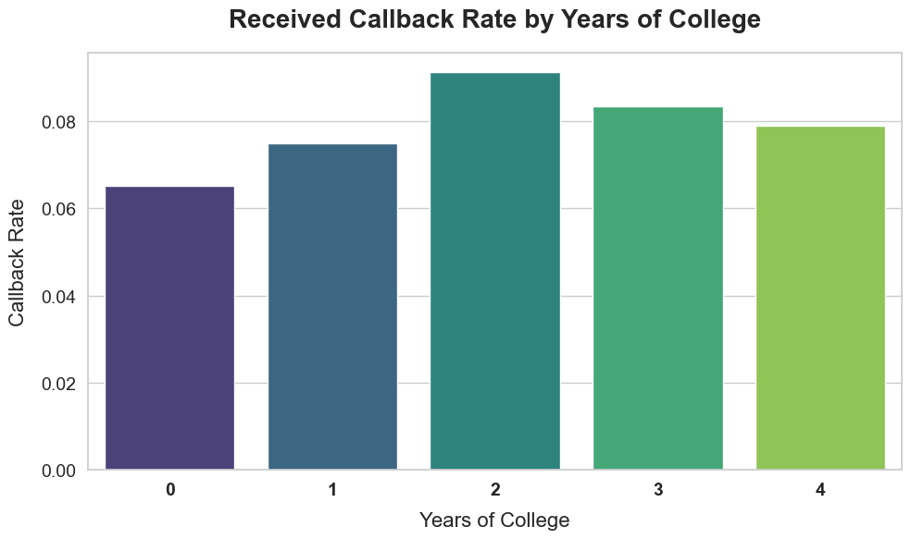
VISUALIZATION 2 (Histogram)
EDA
Unexpected trend with college experience
Candidates with 2 years of college experience have highest callback rate
Surprisingly, those with 4 years show lower callback rates
Notes:
Next, we examined the relationship between years of college experience and callback rate. The histogram here reveals that candidates with two years of college experience had the highest callback rate, which was quite surprising. Even more unexpected was that those with four years of college had a lower callback rate. This suggests that a degree might not always be necessary to secure an interview, and that candidates with less formal education can still perform well.

Slide 5
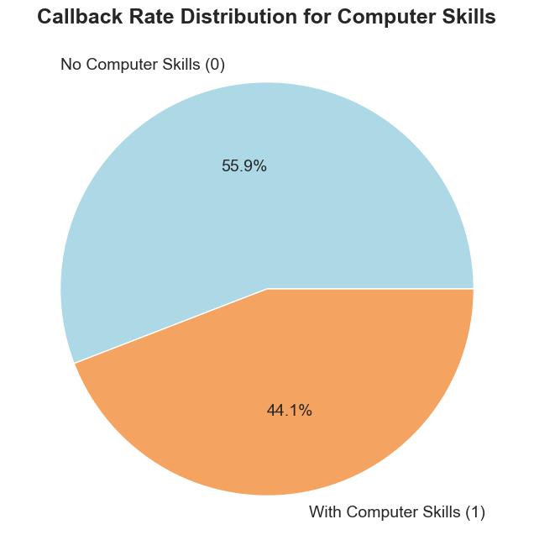
Visualization 3 (Pie chart)
EDA
55.9% of callbacks are for applicants without listed computer skills
44.1% of callbacks are for those with computer skills
Notes:
Here, we look at the impact of computer skills. Interestingly, 55.9% of callbacks were received by applicants who did not list computer skills on their resumes, compared to 44.1% who did. This suggests that other factors, like job experience or soft skills, might be more important than having computer skills for some roles. It also highlights a possible gap between the skills employers are looking for and what candidates are listing on their resumes.

Slide 6
Splitting
Dataset
4870 rows
Features excluded:
firstname
*not relevant for predicting callbacks
Training Set
60%
2922 rows
Validation Set
20%
974 rows
Test Set
20%
974 rows
job_ad_id
*not relevant for predicting callbacks
Notes:
Moving on to how we split the data. The dataset was divided into 60% training, 20% validation, and 20% test sets. This ensures we have enough data for training while being able to assess the model’s performance on unseen data. We also excluded some features like 'firstname' and 'job_ad_id' since they were not relevant for predicting callbacks.

Slide 7


preprocessing
Handling Missing Data
Missing values in 3 categorical columns 'UNK', 'Unknown', and NaN were standardized to "unknown” to maintain consistency
Feature Name
Missing Values
Count
%
Renamed Values
job_fed_contractor
NA
1768
36.3
1768
unknown
job_ownership
Unknown
1992
40.9
1992
unknown
job_req_min_experience
NaN
2746
56.4
2746
unknown
Notes:
When dealing with missing values, we noticed that several columns had placeholders like 'UNK' and 'Unknown' for categorical features. To maintain consistency, we replaced all these missing values with 'unknown.' The affected columns were 'job_fed_contractor,' 'job_ownership,' and 'job_req_min_experience.' After this step, we proceeded to encoding the features.

Slide 8


Feature ENCODING
Ordinal Encoding
Applied to features with a natural order
Example: years_college:
One-Hot Encoding
Used for categorical features with no inherent order
Example: job_ownership
unknown
nonprofit
private
public
0
1
2
3
4
Notes:
To properly handle our categorical features, we used two encoding methods: Ordinal Encoding for features with a natural order, like years of college, and One-Hot Encoding for those without, like job ownership. This allowed us to effectively transform the categorical data into a format suitable for our machine learning models.

Slide 9
Preprocessing
Before Preprocessing
27 features
After Preprocessing
60 features (one-hot encoding expansion)
Final Training Dataset
Contains 2922 data points with 60 features
Notes:
Before preprocessing, we had 27 features. After applying one-hot encoding and ordinal feature encoding transformations, the number of features expanded to 60. Our final training dataset contains 2922 data points, which provides a robust dataset to train our model.

Slide 10
Thank you for listening

